Slide 1

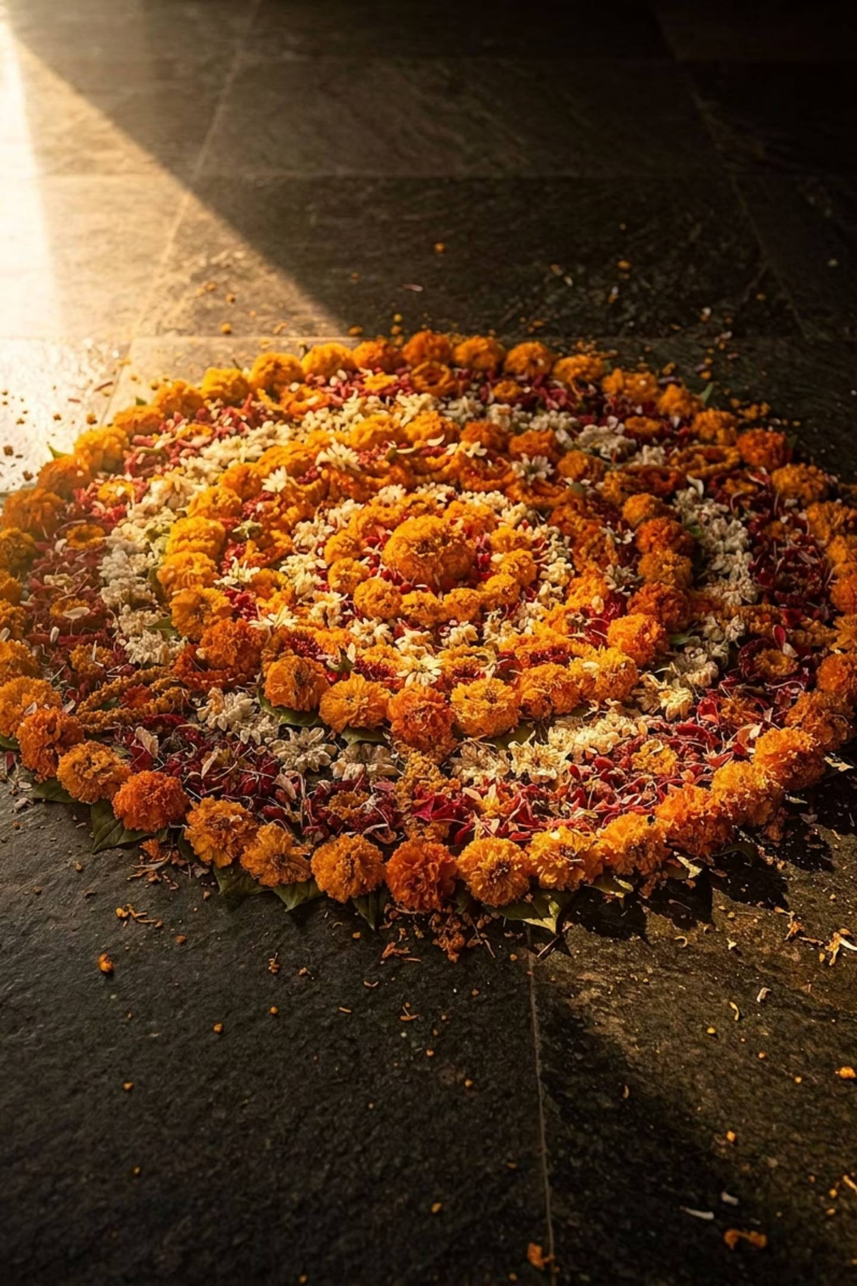
Onam 2026
Presented here is a curated selection of Onam activation concepts, each designed as a standalone experiential property. Clients can choose individual activations or combine multiple formats to create a customized, high-impact festive campaign across Kerala.
ONAM 2026 CAMPAIGN

Slide 2
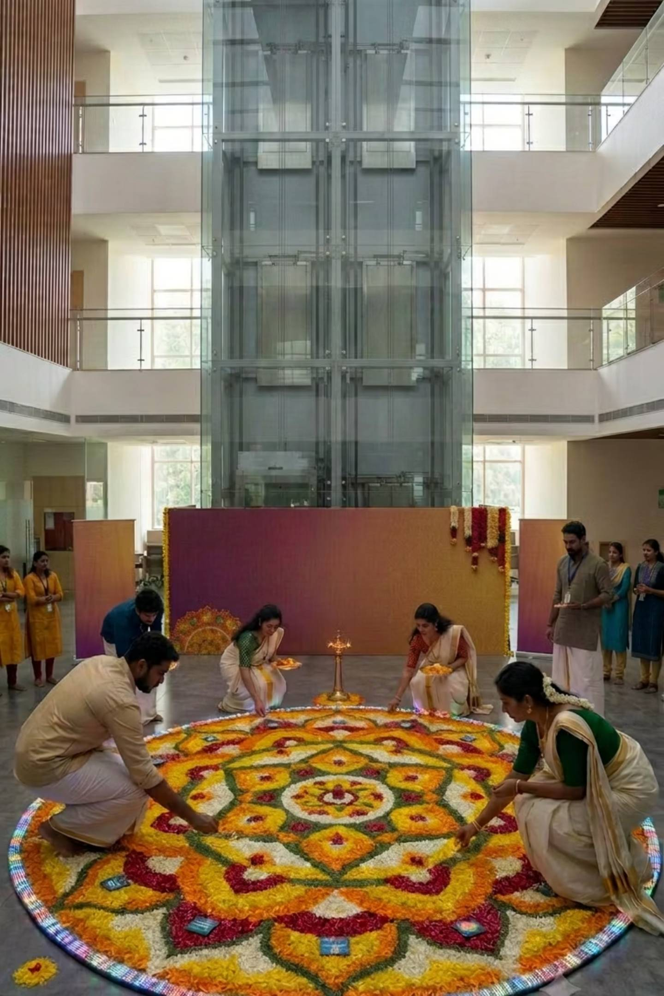
Plan 1
ACTIVATION 01
Vibe Onam — Corporate Pookkalam Championship
Transforming Kerala's leading workplaces into vibrant festive destinations. Corporate teams compete in an Office Pookkalam Championship, with the best advancing to a spectacular Grand Finale at a premium mall atrium.
7-Day Registration
WhatsApp-led sign-up across corporate parks in Kerala
Top 10 Shortlisted
Best offices advance to the Grand Finale stage
Experience Pavilion
LED wall, live judging, drone coverage & RJ interactions
Live Prize Ceremony
Digital photo booth, floral installations & employee games

Slide 3
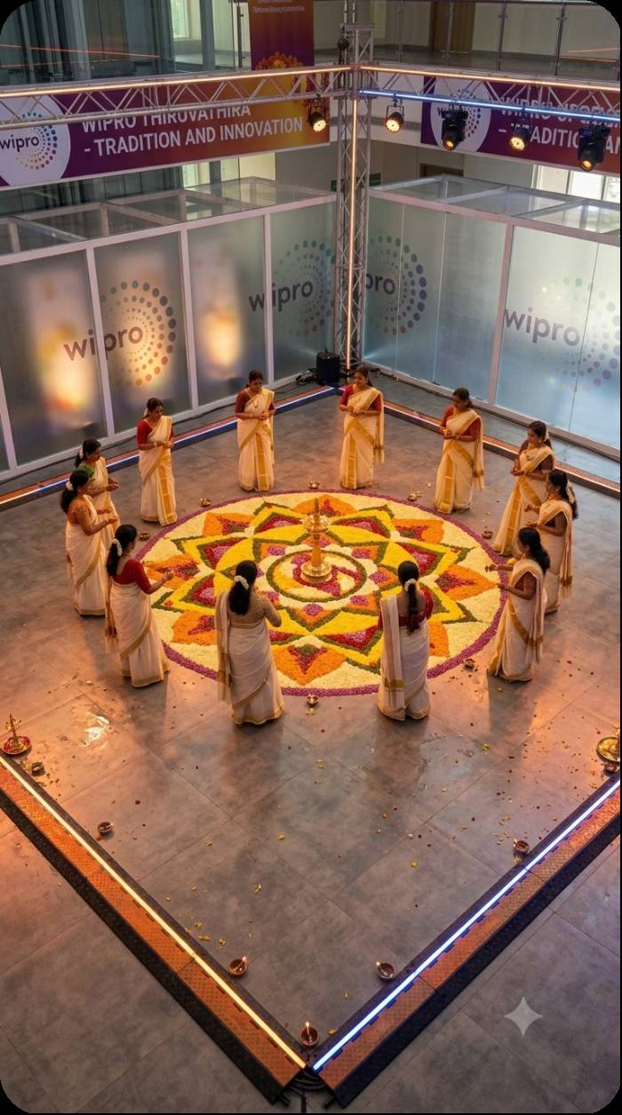
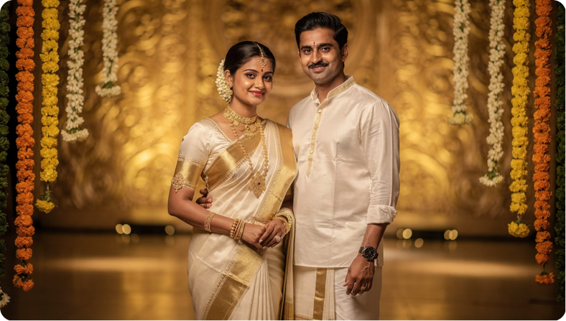
ACTIVATIONS 06 & 07
Plan 3
Plan 2
Kerala Shreeman & Malayali Manka
A 5-day competition celebrating Kerala's most charismatic corporate couples across corporate parks and malls. Rounds include traditional attire, speaking challenges, talent performances and a compatibility round — culminating in a celebrity jury-judged ramp walk and the crowning of Kerala's Festive Couple.
Chinganilavu — RED FM's Signature Onam Festival
A large-scale public celebration uniting Kerala's finest tradition in one destination — Pookkalam Championship, Thiruvathira, Mahabali Parade, Chenda Melam, Kids Art Zone and a Live Onam Food Street. The activation powers the main stage, experience lounges, digital screens and product demonstration areas.

Slide 4
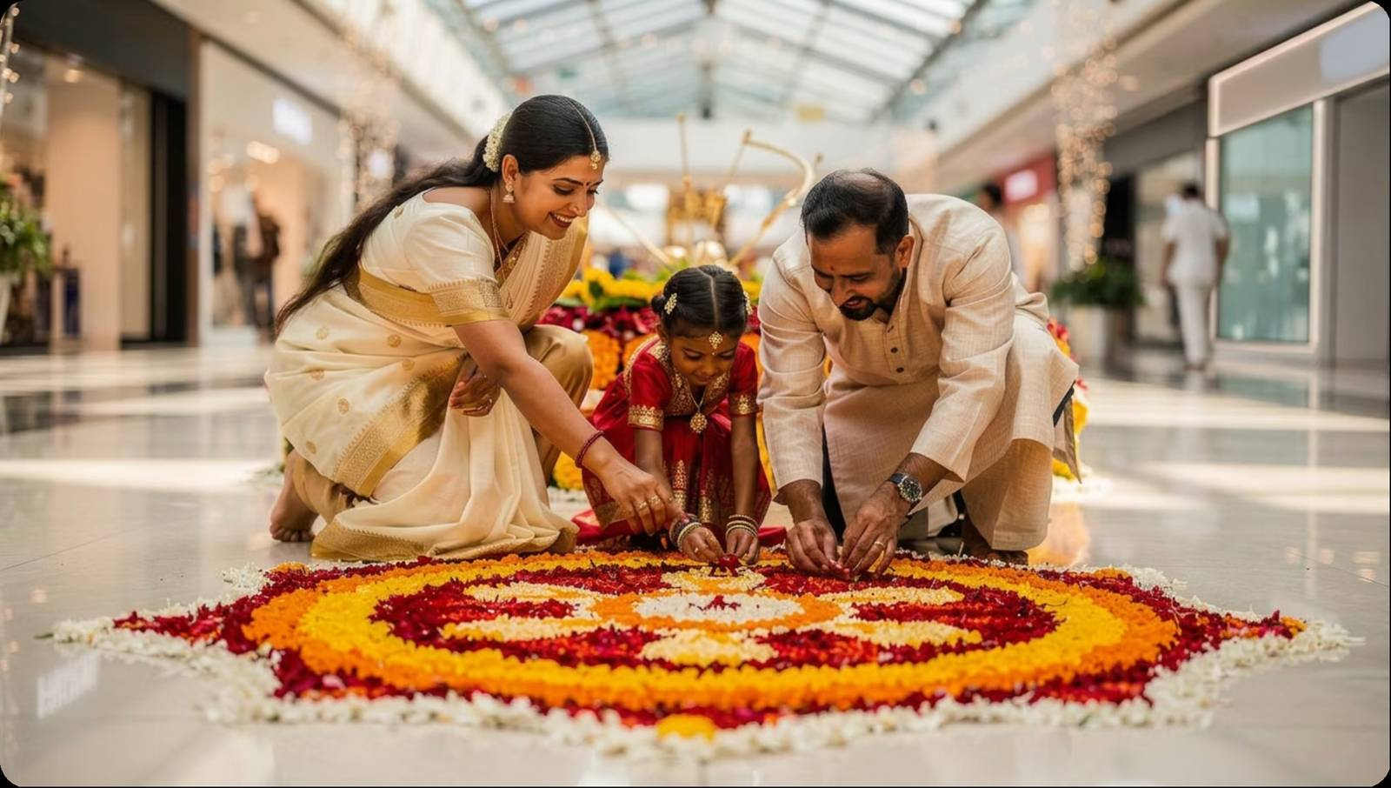

ACTIVATION 02
Plan 4
Onakudumbam — Family Onam Festival
An exclusive family festival in partnership with BNI, held at mall atriums, residents' associations and community halls — where families compete to create Kerala's most beautiful Pookkalam while celebrating together.
Grand Moment: A drone captures a breathtaking aerial mosaic of every completed Pookkalam. Top 3 families win movie experiences, family dinner vouchers and winner trophies.
🏆 Family Pookkalam Championship
🧒 Kids Activity Village
🎭 Mahabali Meet & Greet
🍛 Kerala Food Corner

Slide 5
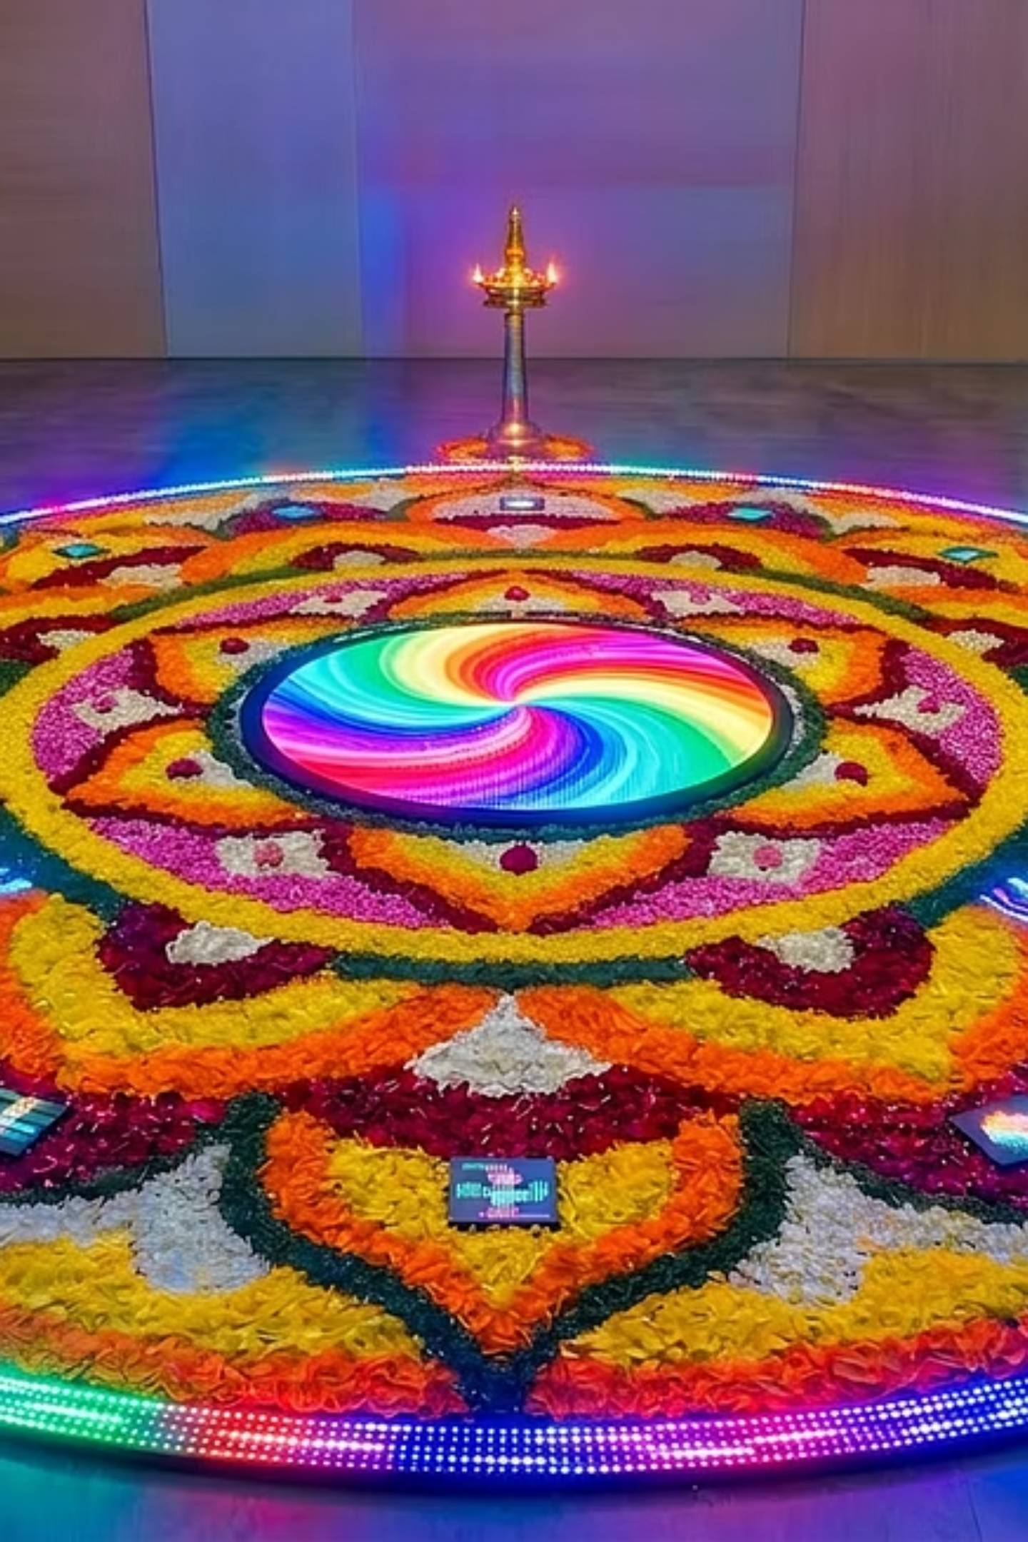




ACTIVATION 03
Plan 5
Tech-Panthal — Technology Meets Tradition
A futuristic experiential dome visiting Kerala's top colleges over 7 days — one college daily — combining innovation story with Onam's creative spirit through the Pixel Pookkalam Championship.
Pixel Pookkalam
Traditional flowers + smart LEDs + projection mapping + interactive motion sensors
Innovation Zone
AI demonstration booth and AR Pookkalam experience
Interactive Experience
LED floor, coding corner, tech quiz arena and live RJ sessions
Online Finale
Winning colleges advance to a public online voting stage

Slide 6
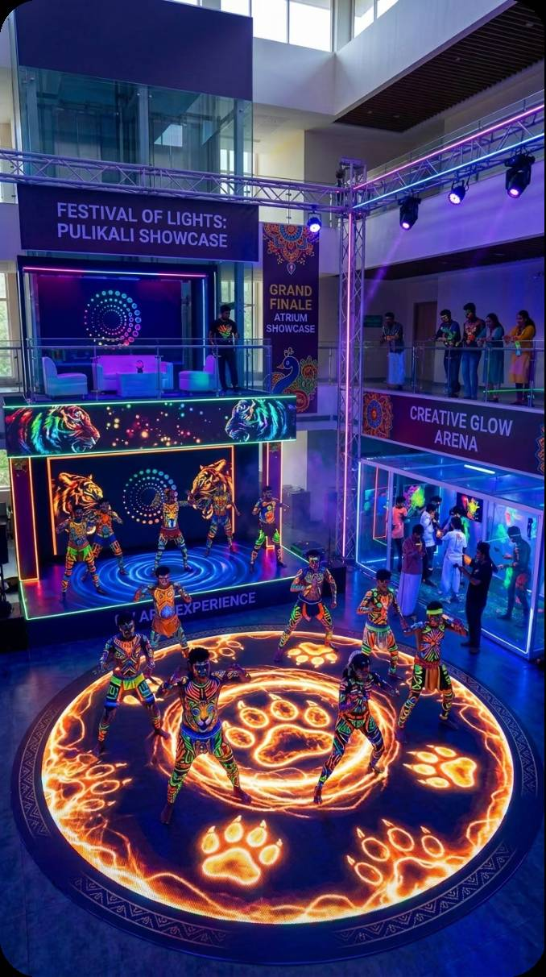
ACTIVATION 04
Plan 6
Neo Pulikali — Tradition in Motion
6-Day Festival Journey
Day 1
1
Traditional Pulikali Parade
2
Day 2
Hip-Hop Fusion
Day 3
3
Neon Pulikali Night
4
Day 4
College Dance Battle
Day 5
5
Audience Flash Mob
6
Day 6
New Face of Kerala's iconic Pulikali tiger dance by blending tradition with contemporary street culture. UV Paint Arena, Blacklight Stage, Interactive Dance Floor and the Glow Lounge — across colleges and mall atriums.
Grand Finale Performance

Slide 7
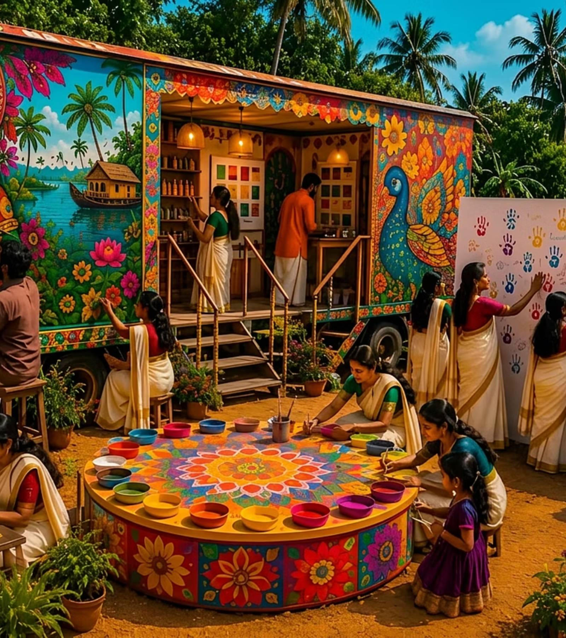
ACTIVATION 05
Plan 7
Hi Onavandi — Colors of Kerala
A travelling art caravan celebrating Kerala's colors, creativity and stories through live art. Over 10 days, students across Kerala submit murals, digital art, folk art and mixed media — and winning artworks travel statewide on the branded LED caravan.
Live Painting Arena
Watch artists create in real time
LED Canter Gallery
Showcasing shortlisted works on the move
Audience Voting
Interactive art wall and live canvas sessions
Mini Workshops
Artist meet & greet and hands-on sessions

Slide 8
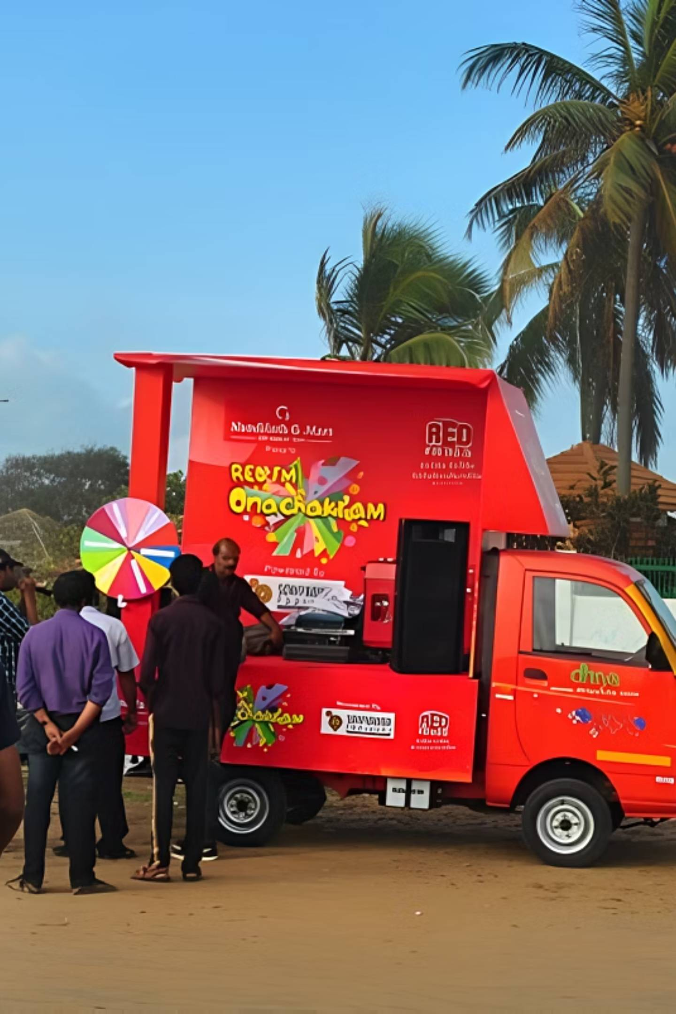




ACTIVATION 08
Plan 8
Ona Chakram — Kerala's Moving Onam Festival
A fully branded RED FM canter van spreading the joy of Onam across 5 cities — Thiruvananthapuram, Kochi, Thrissur, Kozhikode and Kannur — over 15 activation days (3 days per city).
Mini Performance Stage
Live RJ broadcasts and evening LED shows
Digital Experience Wall
Interactive brand touchpoints for thousands
Pookkalam Display
Selfie station and traditional games on-site
Spin & Win
Children's activities and audience engagement at every stop

Slide 9


